Slide 1
Timeline Update
A look ahead to the next 3 months

Slide 2
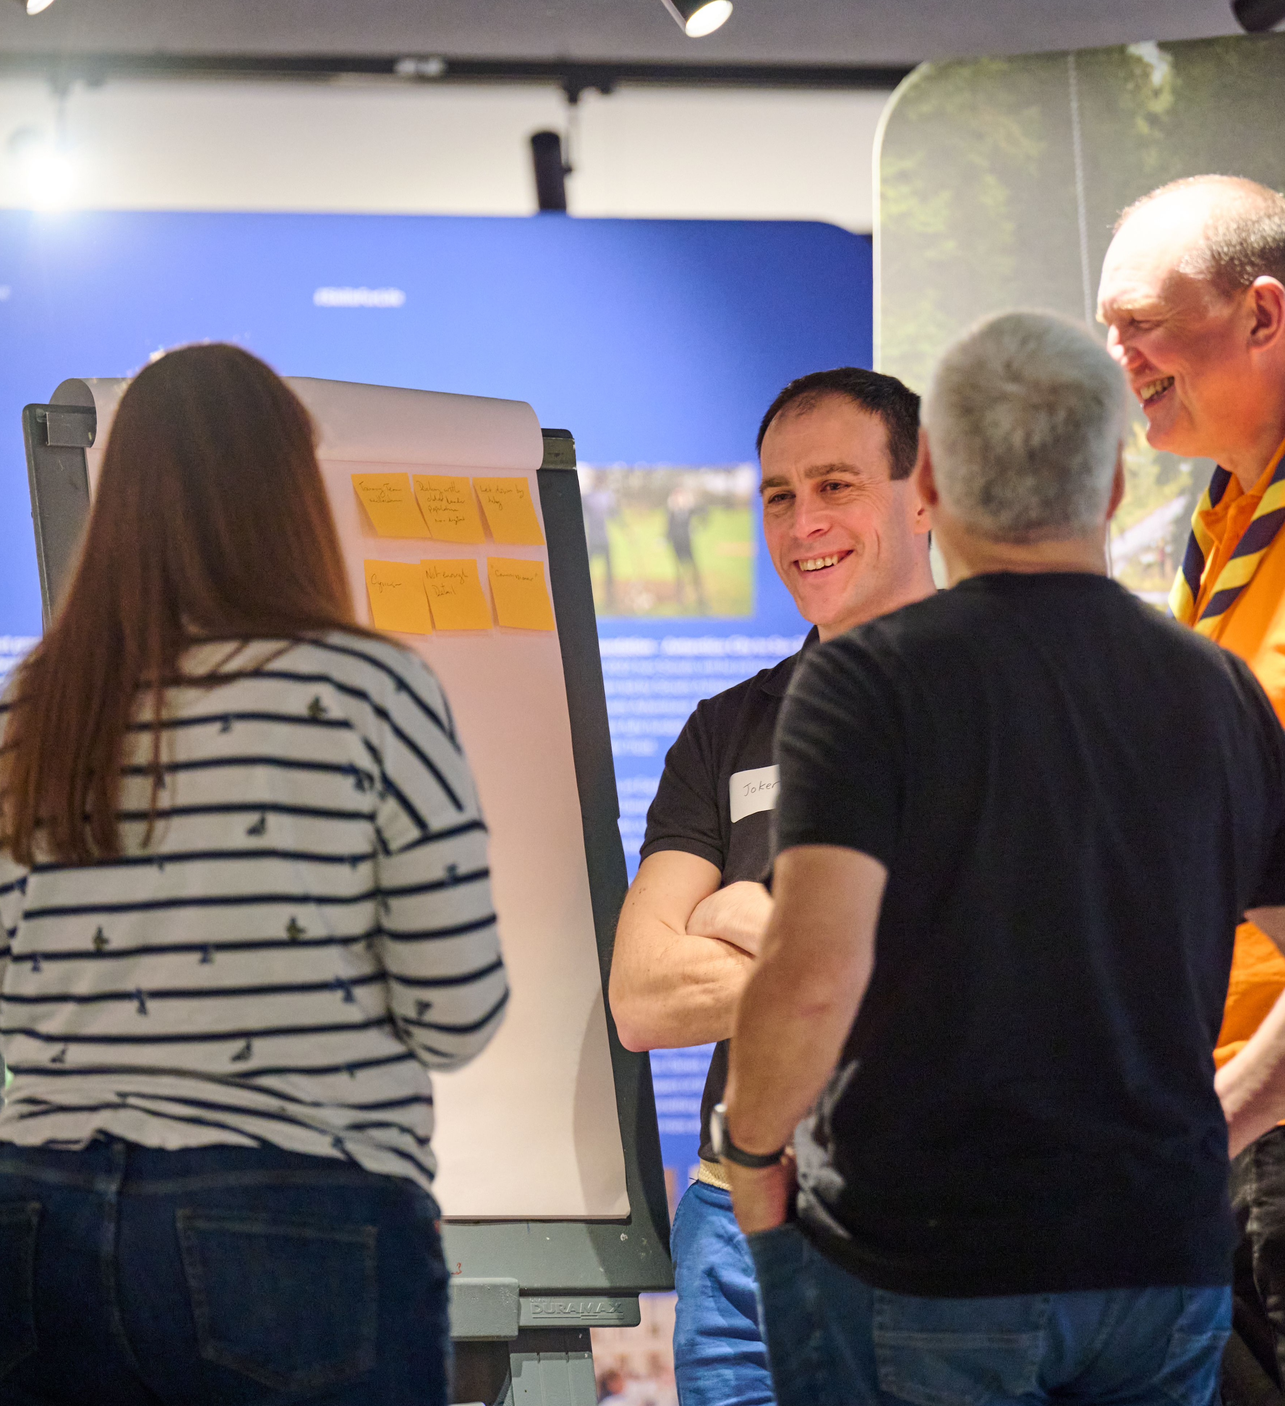
  Where are we now?
Every volunteer has a unique email address recorded against their Compass record.
Completed training has been marked as validated within Compass where required.
Compass records are as up to date as possible across the Region, Districts, Groups, Sections and Units.
The new volunteering structures in your areas are understood, and everyone knows where they fit.
All Executive Committees have transitioned into Trustee Boards in line with POR.

Slide 3
  So, what’s next?
We now have confirmed dates for transition to our new digital tools and processes.
These key dates mark out 3 important phases:
Freeze Readiness - 30th Sept to 6th Nov
Compass Freeze – 7th Nov onwards
Go-Live – 21st Nov onwards
Processes will start to change as we progress through each of these phases, specifically during Compass Freeze. These changes are known as the Interim Processes.

Slide 4
  Freeze Readiness - Now
During this phase, you will need to be aware of a few key changes to processes whilst we prepare for Compass to be frozen.
30th Sept Onwards - Woodbadge recommendations, grant applications and good service award nominations are no longer able to be submitted until Go-Live.
24th Oct Onwards – You will not be able to add new volunteers or add new roles to existing volunteers from this date. You will also be unable to request new disclosures.
Action:
Please ensure all disclosures due to expire before December are requested through Compass before 24th October. The disclosure will be processed by Disclosure Scotland regardless of the freeze period, and the disclosure will appear in the new system once completed.
Keep your Compass record up to date with validated training and any changes to personal details.

Slide 5
  Compass Freeze – 7th November
Compass will go offline for all volunteers from 11.59pm on Wednesday 6 November.
You will have no further access to Compass, including after Go-Live
Our Interim Processes will be in place during the freeze. All the information can be found at scouts.org.uk, with the affected processes highlighted below.
Internal Checks and References
Criminal Record Checks (Disclosures)
Learning
Suspensions
Permits
Nights Away Notifications
Grants and Awards
Scout Store

Slide 6
  Compass Freeze – 7th November
As volunteer records will be inaccessible when Compass goes offline, it’s important that Districts and Regions have access to records to reduce the impact on how Scouts runs locally.
All Regional and District Lead Volunteers will receive an email with a link to a password protected report, followed by a text message with the password. The report will contain the following information for all volunteers within their area:
Within the report, there will be one editable notes section to record any information you need to locally while Compass is offline. You’ll need to use these notes to update the new digital system after Go-Live.
On 12 December these files will be deleted, and all local access removed.
Membership Number
Name
Email Address
Phone Number
Role(s)
Status (Provisional, Full or Suspended)
Region, District, Group, Section
Disclosure expiry date
Safety training expiry date
Safeguarding training expiry date
First Aid training expiry date
Current valid permits

Slide 7
  Go-Live – 28th November
Our new processes will be live from this date, and POR will have been updated to reflect the changes before Go-Live.
You will receive an email with instructions about how to access the new tools between 21st Nov and 5th Dec, depending on your role. Some volunteers may get access before others to allow teams and sub-teams to be created by Lead Volunteers.
  Any Questions?

Slide 8
Our new ways of volunteering
How local Scouting processes will be supported
by the new digital system

Slide 9
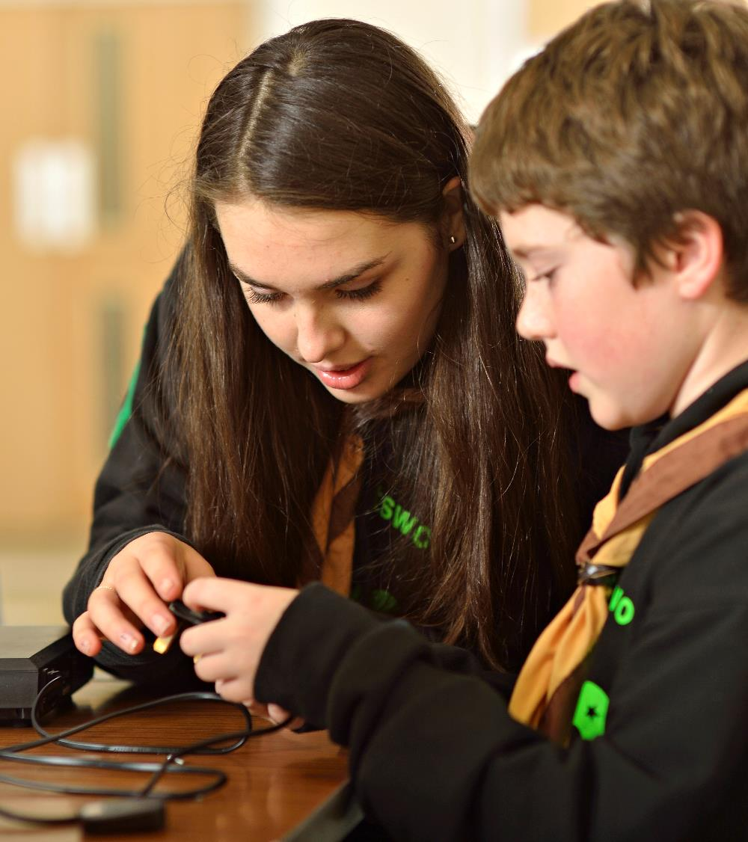
  Introduction
Our new digital system features will replace, add or amend several current local Scouts processes
How you implement these processes locally will need to be built into your preparations for transition
Further detail will be provided during system training
Scouts.org.uk will be updated to refer to these processes over the coming months

Slide 10
  Content
The digital system will support a range of local processes, to significantly reduce the amount of time volunteers need to spend doing ‘admin’
The new digital system has several functions which include:
  Existing local processes which were supported by Compass
  Local processes that are not currently supported by Compass but will be supported by the new digital system
Some functions are optional, and others must be used from Go-Live.

Slide 11
  Colour coding
Colours used in diagrams in this presentation have these meanings
Significant process change
This colour indicates a process, or an element of a process, which has some significant changes from how it's currently completed either via Compass or manually.
This will significantly affect current local processes used by volunteers.
Some process change
This colour indicates a process element which has some changes to the digital process in the new digital system.
Little change
Little (if any) change from the current process (manual or digital).

Slide 12
Functions which MUST be used from Go-Live
Managing my personal details
Managing your local structures
Managing our volunteers
Volunteer Joining Journey
Volunteer Role Change process
Permits
(Activity, Nights Away)
Learning
Good Service Awards
Dashboards & Reporting
Notifications
Minibus Permits
Grant applications
Suspensions
(Adults)
Appointment Reviews
Functions which CAN be used from Go-live
Nights Away Notifications (NAN)
Qualifications
Actions
Attracting new volunteers

Slide 13
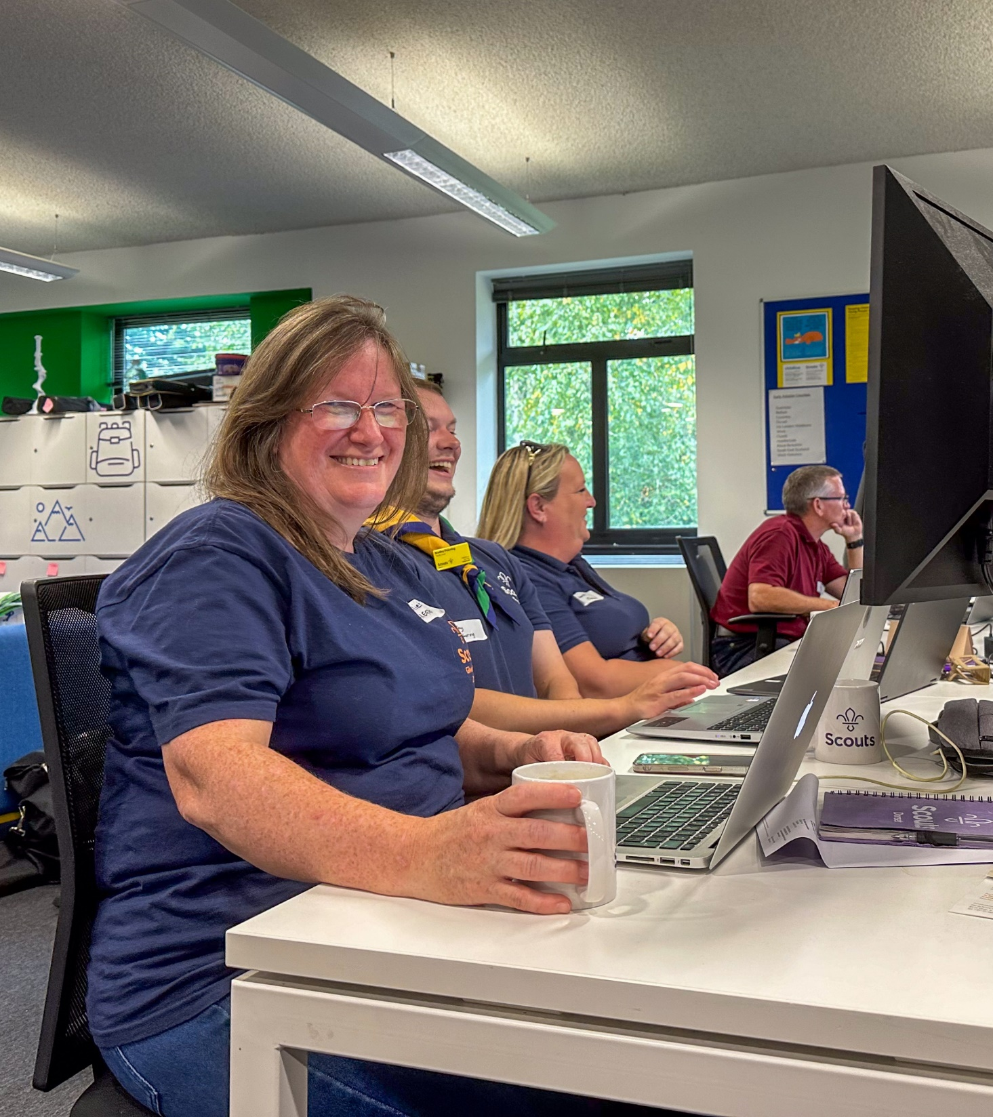
  Local Considerations
While reading through this document, there are several things you might want to think about locally, such as:
Do the volunteers who will support these processes know how they work in the new system?
Will you start using the optional functionality, such as Night Away Notifications, from Go-Live or a later date? How will you let your volunteers know this?
How and when will you retire any local systems which you use for carrying out some of these functions?

Slide 14
Functions which must be used from Go-Live

Slide 15
  Functions currently supported using Compass
  and require use of the new system from Go-Live
Managing my personal details
Managing your local structures
Managing your volunteers
Volunteer Joining Journey
Volunteer Role Change process
Permits
(Activity, Nights Away)
Learning
Good Service Awards
Notifications
Dashboards & Reporting
Suspensions
(adults)
Appointment Reviews

Slide 16
  Changed functions after Go-Live - Overview
Managing my personal details
Line manager creates a new member record and adds initial key details
Volunteer adds their full details and maintains them on the system through their time with Scouts as a volunteer. This self-service approach is a big change from Compass and allows individuals to update their own details.
Managing your volunteers
Team Leaders allocate (or close) roles on the system (e.g. Beaver Section Team Member, or District Programme Team Member)
This initiates the relevant Joining Journey or Role Change processes (see below)
Managing your local structures
Lead Volunteers (including Group Lead Volunteers) or their delegates need to ensure that organisation records on the system are maintained up-to-date for each team in their organisation
This includes adding/closing sub-teams or Sections
Currently, the Appointments Process is used for new volunteers, and a change of role
The significant Go-Live change is that volunteers only join Scouts once and complete the seven aspects of the Volunteer Joining Journey (similar to the current appointment process). All seven steps must be complete within six months (including all Growing Roots learning).
A key difference from today is that the Volunteer Joining Journey will be largely managed by the system rather than by administrators and/or Appointments Secretaries
Volunteer Joining Journey
The Role Change process picks up on any aspects of the Joining Journey that the volunteer has not done but is relevant to their new (or additional) role
Key is that volunteer and new line manager agree that the volunteer has the appetite, commitment and skill for the new or additional role
Volunteer Role Change process
Sept 24 - Version 4

Slide 17
  Changed functions after Go-Live - Overview
Learning will be managed by a Learning management system - an integrated part of the membership system
Once a piece of learning is completed by a volunteer, the volunteer’s record will be directly updated
The volunteer will see clearly the learning that they must do
Wood Badges become optional
Learning
Permits
(Activity, Nights Away)
Volunteer must request a permit (or permit renewal) by making an initial request on the system
Volunteer selects Assessor on the system
After assessment meeting, Assessor makes technical recommendation to District or Regional Lead Volunteer for permit approval (or not)
Good service awards
Any volunteer can nominate any other volunteer for a good service award. This is the only nomination route
Local process decides, as now. Conclusion of that is recorded on system & approvals are passed to UK HQ
Once awarded, the citation will become visible to the Award holder
If the system requires an action to be completed this will be assigned to the appropriate volunteer(s) and a notification will show on their record on the system. Volunteers will see these notifications when they log in
Volunteers who have notifications but who have not logged on to the system for seven days will receive an email message advising them that they have notifications awaiting their action
Notifications
The primary reporting tool is a new feature called data explorer. You can build and save your own customised dashboards from standard reports. Particularly useful for Team Leaders and Lead Volunteers
Users can add new dashboards or queries, either by creating a new dashboard from scratch, or by cloning an existing dashboard
Dashboards and reporting
Sept 24 - Version 4

Slide 18
  Changed functions after Go-Live - Overview
New functionality – not available in Compass; must be used for all grant applications from go-live
From go-live this will be the way to apply for, and track applications for, UK HQ administered grants
It will also be the route to report on the benefits that the grant has delivered (this reporting can be at any time but is typically at the end of the grant period)
Grant applications
Minibus permits
New functionality – not available in Compass; must be used for all minibus permit applications from go-live
This will be the route to apply to UK Headquarters for a minibus permit
The system prompts the need for a ‘formal’ appointment review and creates the appointment review template.
Both the volunteer and the line manager complete their sections of the review template online.
Volunteer and line manager meet to discuss. Both can adjust their wording on the template prior to concluding the review.
Appointment reviews
Suspensions
(adults)
(As now) Lead Volunteer recommends a suspension, which is then confirmed by Lead Volunteer’s line manager
System will automatically lift a ‘compliance’ suspension (linked to learning and/or criminal records check) when the condition(s) are cleared

Slide 19
  Managing my personal details
At time of joining the Scouts, Lead Volunteer or Team Leader* adds a ‘new member’ record to the digital system. System emails new volunteer requesting completion of their personal details.
Volunteers have a responsibility to maintain their personal details up-to-date.
Through self-service, volunteers can update their personal details at any time.
The new volunteer sets their password, then logs in and adds their personal details.
*Additional people will also be able to add new members and their roles
In adding a new volunteer, Lead Volunteer or Team Leader inputs this limited set of information about the volunteer: full legal name, date of birth, postcode, email address, previous surname (if any), membership number (if known)
When updating personal details, most fields can be directly edited by the volunteer. But in a few cases (for example a name change for any reason) a change must be requested, in which case the volunteer is asked to fill in a short online form and attach an e-copy of the relevant ‘evidence’ (for example a marriage certificate). The update will then be made by the Support Centre.

Slide 20
  Managing your local structures
  (Including teams, sub-teams and organisation records)
Lead Volunteer and the Leadership Team agree a new Sub-team, including the Sub-team Leader
(Note: Section Teams cannot have sub-teams)
Lead Volunteer or Team Leader creates new Sub-team and adds Sub-team Leader
The system identifies any Joining Journey or Role Change Journey elements required
Group Lead Volunteer or District 14-24 Team Leader agree to set up a new section
The system identifies any Joining Journey or Role Change Journey elements required
Group Lead Volunteer or District 14-24 Team Leader creates new section and adds Section Team Leader

Slide 21
  Managing your volunteers
  (Including their teams & accreditations)
Team Leader agrees team or Sub-team members with Lead Volunteer
Team Leader adds team role to the volunteer(s) record
System identifies any Joining Journey or Role Change process elements required
Accreditation granter discusses with volunteer; the accreditation, tasks being taken on and any prerequisite learning
Volunteer carries out tasks in the system as agreed
Accreditation granter makes sure pre-requisites have been met and grants the accreditation

Slide 22
  Volunteer Joining Journey (1)
The Volunteer Joining Journey is only for volunteers new to Scouts (or who return more than 30 days after leaving Scouts)
The Volunteer Joining Journey elements required for each role will be shown in the Autumn 2024 edition of POR
The new volunteer’s role status is initially ‘provisional’. When all the required elements are completed, their status will automatically change to ‘full’.
All required Volunteer Joining Journey elements must be complete within six months of the new volunteer being recorded on the system, some individual elements have their own shorter timeframes.
Elements that are of concern (e.g. unsatisfactory references) will be referred to District/Regional Lead Volunteer or to the accredited Volunteer Safeguarding Lead. These can then be handled as appropriate.

Slide 23
  Volunteer Joining Journey (2)
Declarations
Signed online by each new volunteer. Will include charity trustee declarations if the volunteer’s role includes charity trustee responsibilities
References
Reference requests are initiated by the system when volunteer has completed adding their referees’ details
Responses received will be assessed by the system
Unsatisfactory references will be referred to Lead Volunteer or accredited Safeguarding Lead.
If references aren't received within 30 days, applicant will be automatically advised for action
Growing Roots
Completing the learning that all volunteers need to do along with any additional learning specific to their role
Additional learning includes, for example, Delivering a Great Programme for Section Leaders and Team Members
Trustee eligibility check
The Trustee Board Chair (or person appointing an ex officio Trustee role) undertakes regulator-prescribed checks to confirm that the volunteer is not prohibited from being a charity trustee
Internal check
Automatically initiated by the system when the volunteer is added to the system
Welcome Conversation
The applicant meets with their line manager and one other independent person (who must have the Welcome Conversation Volunteer accreditation).
Criminal record check
Initiated by the system when volunteer has completed their self-service personal details

Slide 24
  Volunteer Role Change process (1)
The Volunteer Role Change process is for volunteers currently in Scouts (or who are returning to Scouts less than 30 days after leaving).
Although the Volunteer Joining Journey is not required when existing volunteers move to a new role, any elements of the Volunteer Joining Journey not previously undertaken but required for the new role must be undertaken.
All elements of the Volunteer Role Change process must be complete within six months.
Examples:
  A District Programme Team Member becoming the District Programme Team Leader may require the ‘Leading Scout Volunteers’ learning
  A Trustee who is moving to be a Section Team Member may require references and a Welcome Conversation, plus the ‘Delivering a Great Programme’ learning, because these are not required for a Trustee role
  A Section Team Leader becoming Group Lead Volunteer may require the ‘Leading Scout volunteers’ and ‘Being a Scouts Trustee’ learning and also a trustee eligibility check
  In all cases, an internal check will also be undertaken, and declarations will be re-signed. Also needs a meeting with the Group Lead Volunteer (move to Section Team Member role) or District Lead Volunteer (move to Group Lead Volunteer or Programme Team Leader role)

Slide 25
  The Volunteer Role Change process (2)
Declarations
At every change of role (within team, or in a new team), declarations are ‘signed’ online by each new applicant. Will include charity trustee declarations if the volunteer’s new role includes charity trustee responsibilities
References
If references have not been previously taken and the new role requires references, this will be automatically initiated
Growing Roots
Growing Roots is not required other than completing any of the learning modules required for the new role that have not yet been undertaken.
Trustee Eligibility Check
Required if the new role includes trustee responsibilities, whether or not a previous trustee eligibility check has been undertaken.
Meeting with new Lead Volunteer or Team Leader
The applicant meets with their new Lead Volunteer or Team Leader to ensure clarity about the new team and their role within the team, and to confirm they have the capacity to do the new role.
Criminal record check
Must be automatically renewed every five years or if moving to a role that now needs a criminal records check. It is not undertaken when there is a change of role or team, unless that coincides with the five-year renewal.
Welcome Conversation
If a Welcome Conversation has not previously been completed and if the new role requires one then the system will note this as a required action
Internal check
Automatically undertaken at every change of role or additional role/team

Slide 26
  Activity and Nights Away Permits
Volunteer applies for permit through system, including selecting assessor, attaching supporting documentation
Selected assessor carries out technical assessment and confirms Scout rules knowledge
Technical assessment is recorded on system
Lead Volunteer or accredited Permit Approver confirms applicant’s personal suitability and grants permit on system
Progress of the permit application can be reviewed at any time by Lead Volunteer or by applicant
Assessors are volunteers who have a current Adventurous Activity Assessor or Nights Away Assessor accreditation appropriate to the particular permit.
Permits can be approved by Lead Volunteers, or by persons with the Permit Approver accreditation.
Note that if an assessor is external to Scouts then the confirming Scout rules knowledge step is done by the Lead Volunteer/Permit Approver.

Slide 27
Learning (Renewals & Branching Out)
System will remind volunteers when learning must be renewed
Volunteer undertakes the learning. Completion is automatically recorded on the volunteer’s record or manually by a Learning Assessor (e.g. First Aid)
Volunteering Development Teams, Lead Volunteers and District/Regional Team Leaders can track compliance via dashboards
Volunteers will be able to select from a range of additional learning opportunities.
Some of these will provide skills for their specific role within their team. Others will be optional learnings of interest to volunteers.
As the volunteer completes their learning, this is recorded on the digital system automatically or by a Learning Assessor as appropriate
This additional learning may, if the volunteer wishes, lead to the award of the Wood Badge
Reminders about overdue learning will be automatically sent to the volunteer and their Team Leader
Our continuing training modules will be on My Learning and will be replaced by new Branching Out content over 2025 & 2026

Slide 28
  Good Service Awards
Any volunteer may submit a Good Service Award nomination, including supporting information, attachments and the citation through the system
At the time of creating the submission, award criteria are automatically checked to allow for the creation of the nomination to proceed
Approved/Supported Good Service Award nomination sent to HQ by system
Award sent out by HQ quarterly to the accredited Awards Parcel Recipient
The accredited Award Nominations Supporter or Lead Volunteer will then review (and edit if required) the nomination and approve or reject this
Note that Good Service Awards are: Chief Scout’s Commendation for Good Service, Award for Merit, Bar to the Award for Merit, Silver Acorn, Bar to the Silver Acorn, Silver Wolf.
The citations will now be visible to the Award recipient.
Meritorious Conduct Awards and Long Service Awards continue to be dealt with as described in Chapter 11 of Policy, Organisation and Rules.
If you use local website workflows to process award applications, consider freeze and retirement plans for them.

Slide 29
Notifications
(Automated Messages, Emails)
Automated notifications
If an action needs to be completed this will be assigned to the volunteers and a notification sent in system.
Volunteers will see these notifications when they log in.
Email reminder
Volunteers who have notifications and who have not logged on to the system for seven days will receive an email message advising them that they have notifications awaiting their action.
This email is designed to keep volunteers aware that there are tasks allocated to them, but not sending them an email every time a new action is created for them.
Messages to team members
Members of a team or sub-team can send a message to the members of their team or sub-team or ‘unit’ (e.g. Group).
This will be delivered as an email to each volunteer.

Slide 30
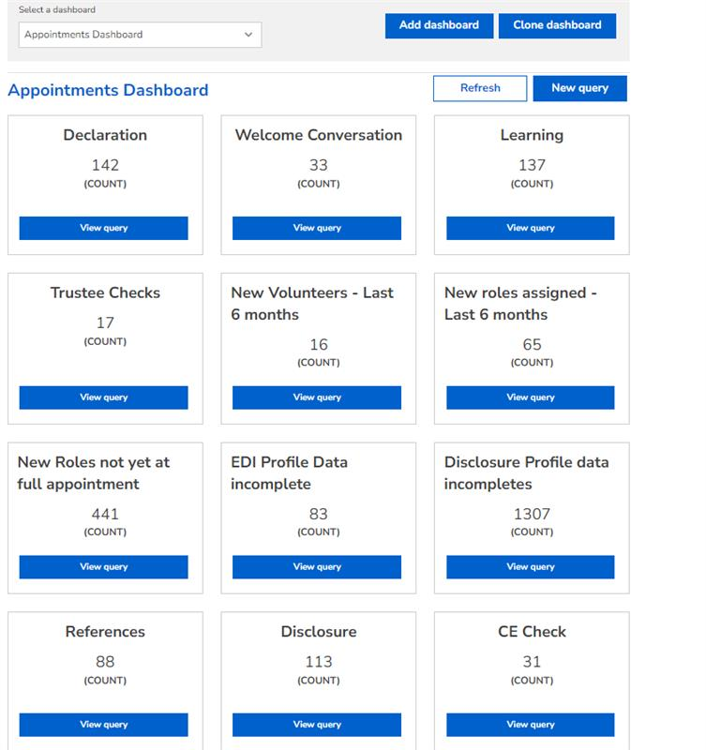
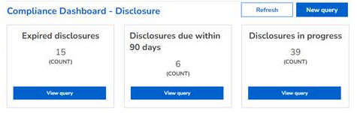
  Dashboards & Reporting
The primary reporting tool is a new feature called data explorer
This slide show examples of the dashboards generated
Clicking on each tile in the system will show the detail behind this information
You can build and save your own customised dashboards from standard reports
You can share your dashboards with others, who will then be able to view the information relevant only to them

Slide 31
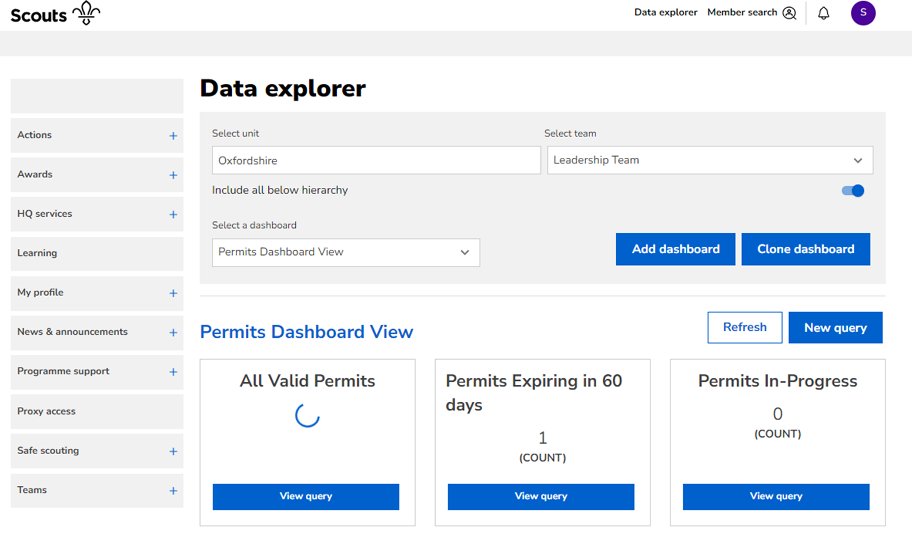
  Dashboards & Reporting
Users can add new dashboards, either by creating a new dashboard from scratch, or by cloning an existing dashboard.

Slide 32
  Appointment Reviews
The system contains the current template for the appointment review process
Both the volunteer and their line manager can access this
This latest appointment review will be recorded and visible in the system and overwritten after each subsequent review
INITIATE REVIEW
System prompts the need for a ‘formal’ appointment review and creates the appointment review template.
Team Leaders can adjust the actual timing, in conversation with the volunteer.
VOLUNTEER CONFIRMATION
Volunteer confirms the wording and conclusions.
CLOSURE
System closes the appointment review. It remains ‘open’ for both parties to view at any time until the next appointment review.
LINE MANAGER CONFIRMATION
Line manager confirms the wording and conclusions.
COMPLETING THE TEMPLATE
Both the volunteer and the line manager complete their sections of the template online.
THE REVIEW MEETING
Volunteer and line manager meet to discuss. Both can adjust their wording on the template.
First review auto-scheduled to be 1 year after start; then every 5 years. But dates can be manually reset as appropriate.

Slide 33
  Suspensions
This process is applicable to any adult member who has reached their 18th birthday. See POR for more details on the suspension process.
Lead Volunteer recommends a suspension for a member
Lead Volunteer’s line manager reviews the suspension request and approves or rejects the request.
Lead Volunteer can add a comment.
For an approved suspension:
1. Lead Volunteer advises member and their Team Leaders of the suspension
(where possible, before approving in the system)
2. The system will automatically send a notification to the member and each of the Member’s Team Leaders.
3. From suspension, Member will have only limited access to the system.
System will automatically lift a ‘compliance’ suspension (linked to learning and/or criminal record check) when the condition(s) are cleared
The member and line manager will be automatically notified that the suspension is lifted.
For other local suspensions, the Lead Volunteer who recommends the suspension, investigates the conditions leading to the suspension and records this on the system
The recommended outcome is made to the approving Lead Volunteer who reviews the investigation and determines the final outcome.
The approving Lead Volunteer records the final outcome on the system. This will be to end membership, end role, or re-instate.
Sept 24 - Version 4

Slide 34
New functions which can be used from Go-Live

Slide 35
  Overview
The functions listed in this section are encouraged, but optional to use from Go-Live
This section provides a brief overview of these functions so that you can prepare for these locally
All Districts and Regions are strongly encouraged to consider early adoption of the Nights Away Notification process

Slide 36
  New functions which can be used from Go-Live
New functionality – not available in Compass; very strong encouragement for use from go-live
Provides a standard way to apply for a Nights Away activity authorisation
Applicant can upload all event details (programme, risk assessments, etc.) as well as providing the NAN detail
All adult appointment data needed by the approver will show online (for all attending adults: status of adult criminal record checks, mandatory learning, nights away permits, etc.)
Nights Away Notifications (NAN)
New functionality – not available in Compass; use encouraged, but not vital, from go-live
Volunteers can add certificates of their ‘qualifications’ to their record
For example: qualifications for non-permit activities (e.g. shooting), food hygiene qualifications, certificates of First Aid other than First Response
Qualifications
Actions
New functionality – not available in Compass ; not vital, but teams can use this functionality from go-live
For use by a team to record agreed action points, for example resulting from a programme planning meeting
Attracting new volunteers
New functionality – not available in Compass; can be used from go-live
This is additional to our ‘traditional’ recruitment methods
This will enable volunteer vacancies to be advertised online and responded to by interested potential volunteers.

Slide 37
  Nights Away Notifications and authorisations
Volunteers submit their Nights Away Notifications (NAN), including risk assessment, and names and membership number of adults attending in the system
System adds permit details, learning compliance and criminal record check status of all attending adult members
Lead Volunteer or accredited Nights Away Approver reviews the NAN form and attached supporting documents
Lead Volunteer or accredited Nights Away Approver approves or rejects the NAN
Comments can be added (e.g. a condition to be met for the NA)
After approval (or if the NAN is initially refused), if there are changes made to the NAN it will reset and go round the approval route again.
However, approved NAN forms can be updated up to the start date of the event by the Approver to reflect actual numbers who will attend a residential activity.
You should plan to retire any NAN workflows on County or District Websites once the new tool goes live

Slide 38
Go-Live Support
How we will support you through this transition journey

Slide 39
  Introduction
There are lots of changes to understand as we transition to new processes and supporting tools
Several cultural and technological changes will take time to bed in
Local support is needed additionally to the support provided by headquarters staff and volunteers

Slide 40
  Go-Live Support
Our local team will…
Provide the first line of support for local volunteers to get advice to resolve ‘how to’ queries using knowledge to support both the local processes used by our volunteers, and questions about the new digital tools that support those local processes
Signpost volunteers to pages on the Scout website or to the Digital Skills Tool and Digital Champions to provide support
Enable people to utilise the new digital systems and understand the changes in local processes
Identify issues raised within the Region that need referring to the HQ Support Centre
Receive and manage local referrals from the Support Centre
And ultimately…
The team will be here to support you throughout this journey until at least February 2025.

Slide 41
  How do I request support?
Have a look at the resources and information at scouts.org.uk. There is a lot of information available already to help you understand how our processes will be changing and what to do when.
Ask your fellow volunteers to see if they know the answer to your question. Peer support will really help us deliver a successful transformation to our new processes and digital tools.
Email us at transformation@sesscouts.org.uk. One of the team will be in touch.
You can also check out the Transformation webpage at sesscouts.org.uk for useful links and resources.

Slide 42
  Useful Links
Interim Processes
Accreditations
Learning Tree
What training isn’t initially becoming Branching Out Learning?
Volunteer Joining Journey
Volunteer Induction
Welcome Conversation Learning
About our new digital tools
Digital Skills Tool

